Slide 1
ANALOG TV - FORMATS

Slide 2
Topics
Analog TV formats
NTSC, PAL and SECAM Comparison
Analog TV and Digital TV Comparison

Slide 3
Analog TV Formats
There are 3 different formats for Analog TV:-
  NTSC
  PAL
  SECAM

Slide 4
NTSC
NTSC stands for National Television System Committee
NTSC was the first widely adopted broadcast system
This was developed in 1940 by FCC (Federal Communication Commission) in US
Uses 2:1 Interlaced scanning i.e., 2 interlaced fields per frame
In the complete raster (ignoring half-lines), the even-numbered or 'lower" scan lines (lines 21 to 263 in the video signal) are drawn in the first field, and the odd-numbered or "upper" (signal lines 283 to 525) are drawn in the second field, to yield a flicker-free image at the field refresh frequency of approximately 59.94 Hertz (actually 60 Hz/1.001).
Each frame consists of a total of 525 scan lines
  486 make up the visible raster
  The remainder (the vertical blanking interval) are used for synchronization and vertical retrace, and can contain other data such as closed captioning and vertical interval time code (VITC)
Advantage: Use of 30 frames per second reduces flicker on the picture

Slide 5
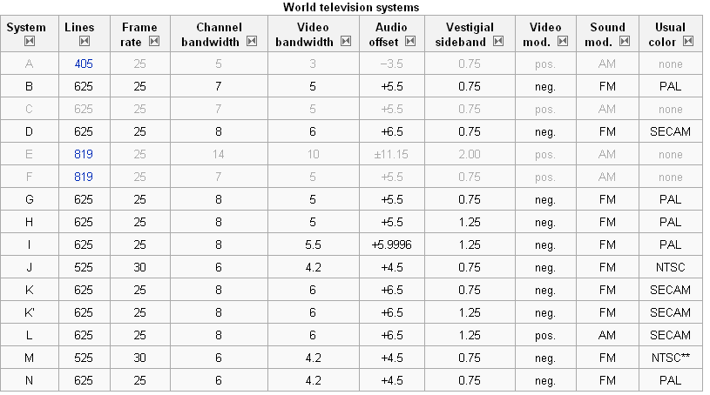
World TV systems – ITU scheme

Slide 6
NTSC Variants
NTSC-M is the same as NTSC
NTSC 4.43 is a pseudo color system which transmits NTSC encoding (525/29.97) in a color subcarrier of 4.43 MHz instead of 3.58 MHz. The resulting output is only viewable by TVs which support the resulting pseudo-system (usually multi-standard TVs). Using a native NTSC TV to decode the signal yields no color
NTSC-J: Used in Japan. Black level and blanking level of the signal are identical (at 0 IRE), as they are in PAL, while in American NTSC, black level is slightly higher (7.5 IRE) than blanking level

Slide 7
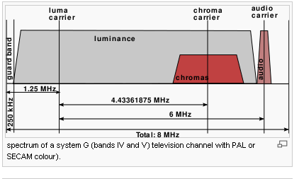
PAL
PAL stands for Phase Alternating Line
Reason for PAL standard to emerge: In the 1950s, when the Western European countries were planning to establish color television, they were faced with the problem that the American NTSC standard would not fit the 50 Hz AC frequency of the European power grids
Advantage is the usage of MORE scan lines(more picture details is available)
The frequency of the sub carrier is approximately 4.43 MHz for PAL
The name "Phase Alternating Line" describes the way that the phase of part of the color information on the video signal is reversed with each line, which automatically corrects phase errors in the transmission of the signal by cancelling them out

Slide 8
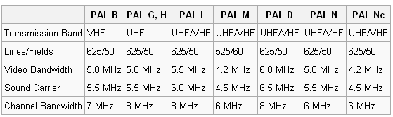
PAL – Broadcast systems
7-MHz channels are used in VHF (B, D) and 8-MHz channels in UHF (G, K, I), although Australia uses 7-MHz channels in UHF and Ireland uses 8-MHz channels in VHF

Slide 9
SECAM
SECAM, also written SÉCAM (Séquentiel couleur à mémoire, French for "Sequential Color with Memory"), was first used in France
SECAM was the first European color television standard
SECAM differs from the other color systems by the way the R-Y and B-Y signals are carried:
  SECAM uses frequency modulation to encode chrominance information on the sub carrier
  Instead of transmitting the red and blue information together, it only sends one of them at a time, and uses the information about the other color from the preceding line. It uses a delay line, an analog memory device, for storing one line of color information. This justifies the "Sequential, With Memory" name
Since SECAM transmits only one color at a time, it is free of the color artifacts present in NTSC and PAL resulting from the combined transmission of both signals

Slide 10
SECAM Varieties (L, B/G, D/K, H (Broadcast))
There are five varieties of SECAM (L, B/G, D/K, H (Broadcast)
SECAM-L or French SECAM : Used only in France, Luxembourg and Tele Monte-Carlo Transmitters in the south of France
SECAM-B/G: Used in the Middle East, former East Germany and Greece
SECAM D/K: Used in the Commonwealth of Independent States and Eastern Europe (this is simply SECAM used with the D and K monochrome TV transmission standards)
SECAM-H: Has been introduced in order to make more space available inside the signal for adding teletext information. Identification bursts have been made per-line (like in PAL) rather than per-picture.
SECAM-K: French overseas possessions and many French-speaking African countries use the SECAM-K standard and a mutually incompatible variant of the channel information for VHF channels 4-9 (not channels 2-10).

Slide 11
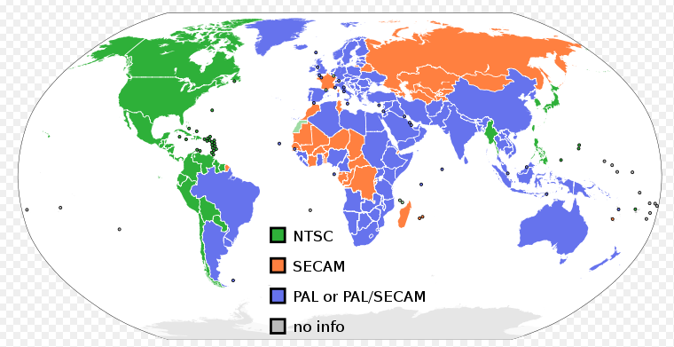
NTSC, PAL, SECAM - country wise
 | NTSC | SECAM | PAL
Country | Americas, Japan, South Korea, Taiwan, Philippines, Burma and some Pacific countries | Eastern Europe and France | Western Europe, Australia, Eastern South America, India (120 countries)

Slide 12
NTSC, PAL and SECAM Comparison
Feature | NTSC | PAL | SECAM
Analog interface | Composite video | Composite video | Composite video that uses FM for chrominance information
Lines/field (Spatial resolution) | 525/60 | 625/50 (Higher number of scan lines increases picture detail) | 625/50 (Higher number of scan lines increases picture detail)
Frame repetition rate (Temporal resolution) | 30 frames/sec (Higher frame rate reduces flicker) | 25 frames/sec | 25 frames/sec
Signal to Noise Characteristics | Higher signal to noise ratio reduces picture noise | Slightly worse | Slightly worse
Gamma ratio | 2.2 | Higher gamma ratio increases picture contrast | Higher gamma ratio increases picture contrast

Slide 13
NTSC, PAL and SECAM comparison (contd)
Feature | NTSC | PAL | SECAM
Horizontal Frequency | 15.734 kHz | 15.625 kHz | 15.625 kHz
Vertical Frequency | 60 Hz | 50 Hz | 50 Hz
Color Subcarrier Frequency | 3.579545 MHz | 4.433618 MHz (Higher colour sub-carrier frequency increases luminance signal bandwidth) | 4.25 MHz (Higher colour sub-carrier frequency increases luminance signal bandwidth)
Video Bandwidth | 4.2 MHz | 5.0 MHz | 5.0 MHz
Sound carrier | 4.5 MHz | 5.5MHz | 5.5MHz

Slide 14
Analog TV and Digital TV comparison
Feature | Analog | Digital
Picture Resolution | Good | Very good
Audio quality | Good | Superior
Multicasting | Not possible | Possible
Computers and Internet | Not possible to connect | We can connect
Interactive games | Not possible | Possible
Consistency of reception over varying distances | Not very good | Good
Standards | NTSC, PAL, SECAM | DVB, ATSC, ISTB
Modulation used | AM, FM | QPSK,QAM,OFDM

Slide 15
Thank you

Slide 16


